Slide 1
PREDICTING TV RENEWNAL\CANCELATION BY ARTUR GREGORIAN ”On my honor, as a student, I have neither given nor received unauthorized aid on this academic work"

Slide 2
“RENEW BROOKLYN NINE NINE I ONLY WATCH LIKE 4 THINGS THIS IS ONE OF THE THINGS #RenewB99”
-Tweet from Lin-Manuel Miranda
Notes:
One of my favorite television shows is Brooklyn Nine-Nine. I had first heard of its cancellation on reddit on the day it was announced. Reddit and Twitter were ablaze in public outry calling for the show to be rescued and the next day NBC picked up the show.
This tweet from Lin-Manuel Miranda had 76k retweets and 215k likes, all in the span of a day.
This is the main interest in this project. Is it possible to predict a shows renewal or cancelation based on user reviews?

Slide 3
BUSINESS UNDERSTANDING
BACKGROUND
1

Slide 4
BUSINESS UNDERSTANDING
STEP 1
STEP 2
STEP 3
COLLECT A LIST OF CANCELED AND RENEWED TELEVISION SHOWS.
FIND ALL THE IMDb LINKS FOR THE SHOWS AND
COLLECT ALL THE RELEVENT IMDb DATA.
COLLECT ANY TWITTER DATA.
Notes:
The first part of this project is simple, I needed to collect titles of canceled and renewed TV show. This came from meta critic from the 2017-2018 tv season.
Once the list of shows was compiled, I used and advanced IMDb query url to find TV shows matching the shows name from the previous step. For the most part, this was straight forward. However, the title used on Metacritic and the titled used on IMDb didn’t always match up. In those cases, I added code to “nudge” the search algorithm in the right direction.
Once the imdb link were collected, I could start collecting the data from IMDb. This includes 3 pages or 75 reviews for each tv show. All web scraping was done using Beautiful Soup instead of xpath extraction.
The last step was to get the twitter followers using the twitter api and the tweepy python package. This actually proved to be the most difficult step. IMDb has a section for official sites, however, a majority of IMDb pages do not have the data populated. The instances were I had that data available to be made finding the correct twitter user much easier, simply go to the webpage, scrape the UID and push it through the twitter api to get all the info I needed. The challenge was finding a way to fill in the gaps.

Slide 5
COLLECTION TECHNIQUES
Check 1
Is any part of the twitter name and the query string (show title) equal to each other.
Check 2
Does the word Official exist in the description.
Check 3
Is the shows network mentioned in the description.
Check 4
Is the shows network mentioned in the twitter name.
Check 5
Does the Twitter name exactly match the query string (show title) with or without spaces. i.e The Rise or TheRise.
Check 6
Does the Twitter screenname exactly match the query string
Notes:
To overcome the challenge of filling in the gaps. I developed a series of checks and built a crude algorithm to determine the highest likelihood that one of the search results is the correct twitter user. If for example checks 1 and 2 and 3 or 4 are true, I assigned it a weight of 1. As an additional step, if the account was verified, I multiplied the weight by 2. These number are arbitrary, however, it returned with a high degree of accuracy the correct twitter IDs for the correct TV show.

Slide 6
2,604,524
17,083
276
Words from all review text.
Total number of reviews collected
Total number of shows collected

Slide 7
ANALYSIS
KEY FINDINGS
2

Slide 8
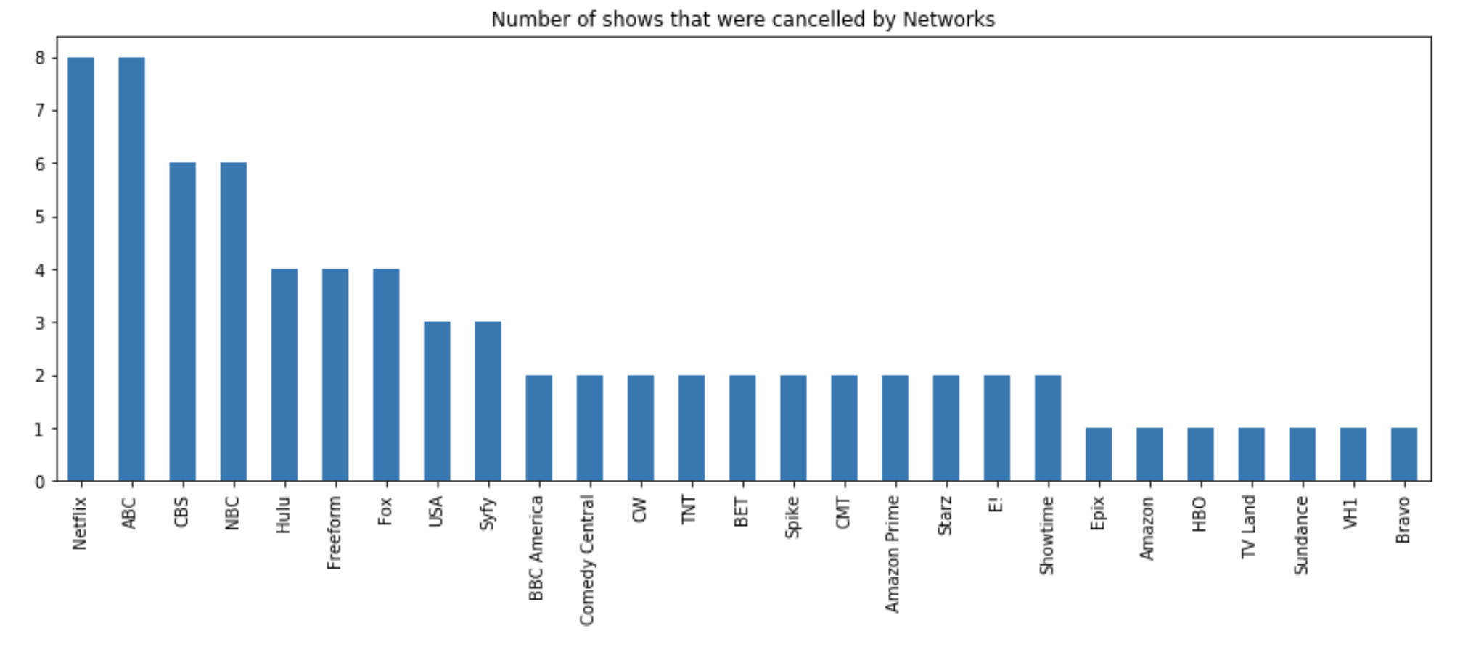

Slide 9
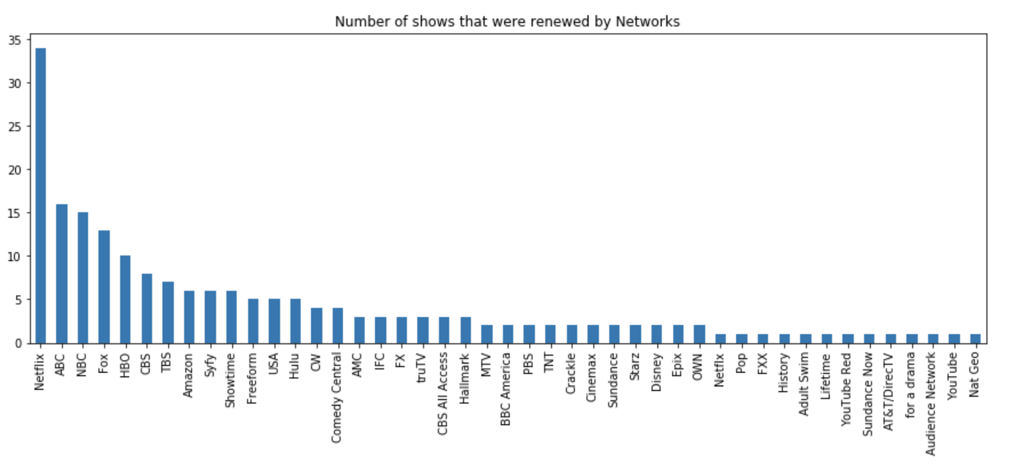

Slide 10
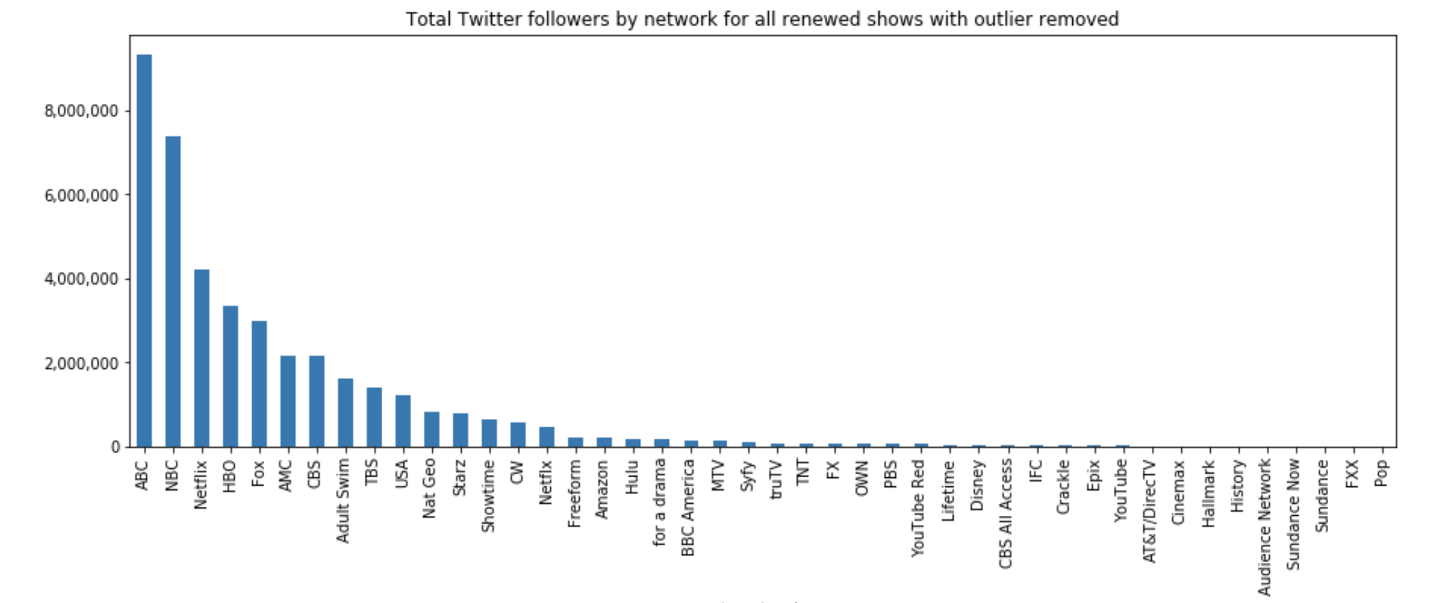

Slide 11
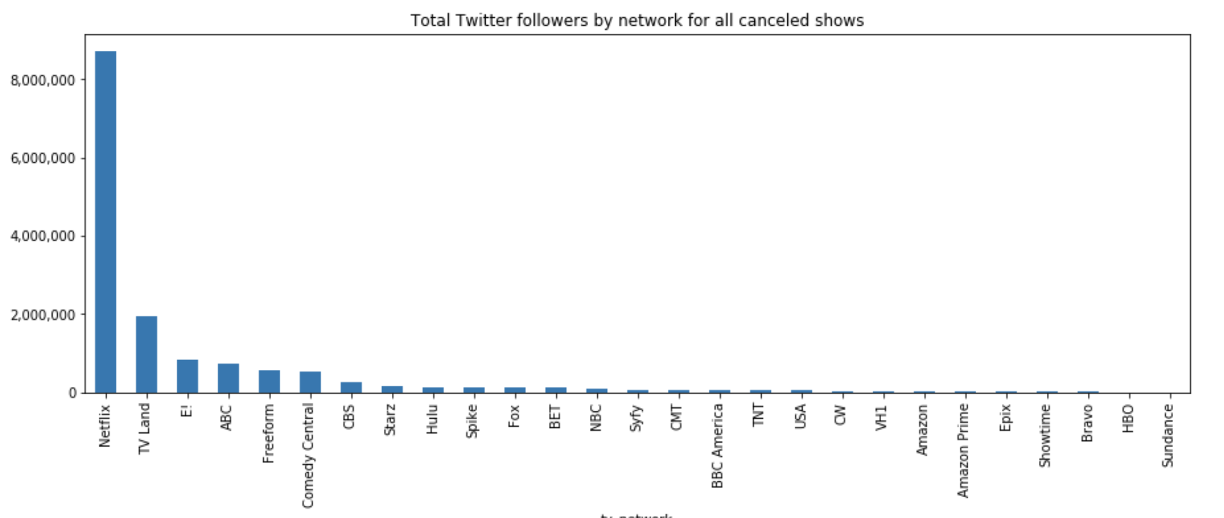

Slide 12
SENTIMENT ANALYSIS
RENEWED
POSITIVE: 53.93%
NEGATIVE: 25.59%
NEUTRAL: 20.49%
CANCELED
POSITIVE: 53.85%
NEGATIVE: 26.81%
NEUTRAL: 19.34%
RESCUED
POSITIVE: 74.67%
NEGATIVE: 12%
NEUTRAL: 13.33%

Slide 13
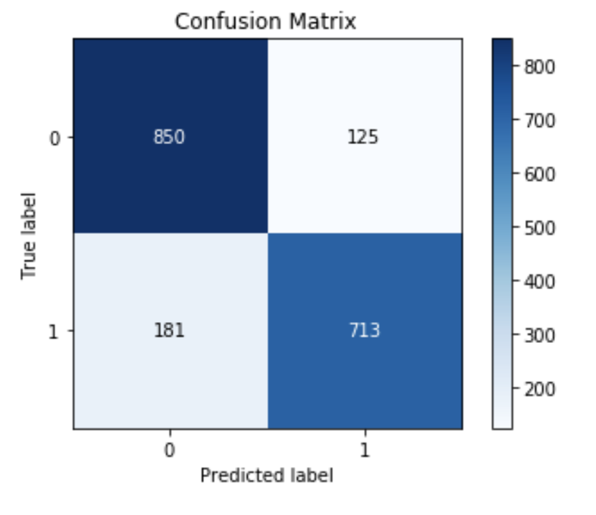
NAIVE BAYES TEXT CLASSIFICATION MODEL
83.6% OVERALL ACCURACY
713 REVIEWS CORRECTLY CLASSIFIED
181 FALSE NEGATIVES
125 FALSE POSITIVES
Notes:
I found the naïve bayes text classification model to be the most accurate model for this dataset. NB model had an accuracy of 83.6% while KNN had 50.8% and SVM has 79.3%.

Slide 14
MODEL DEPLOYMENT
RENEWED
CANCELED
Notes:
I chose to pull 75 reviews from one renewed and one canceled tv show from the 2018-2019 season. Going it this, I was interested to see the results of the model for Santa Clarita Diet as it’s story is very similar to Brooklyn Nine-Nine. It is a highly popular tv show and Netflix announced its cancelation, people went to reddit and twitter to complain.
The NB model correctly classified 72 of the 75 reviews for Bosch and determined it was a renewed tv show. That’s an accuracy of 96%. Santa Clarita Diet didn’t fair so well, only 14 of the 75 reviews were correctly classified as canceled.
This is interesting because it suggests that the fanbase for this show really like it and based on their reviews foresee it continuing on.
A cancelation of well received shows like this could have detrimental consequences to a network which could include a loss in subscribers\consumers.

Slide 15
THANKS!

